Slide 1








Slide 2




Slide 4



Slide 5





Slide 6




Slide 8
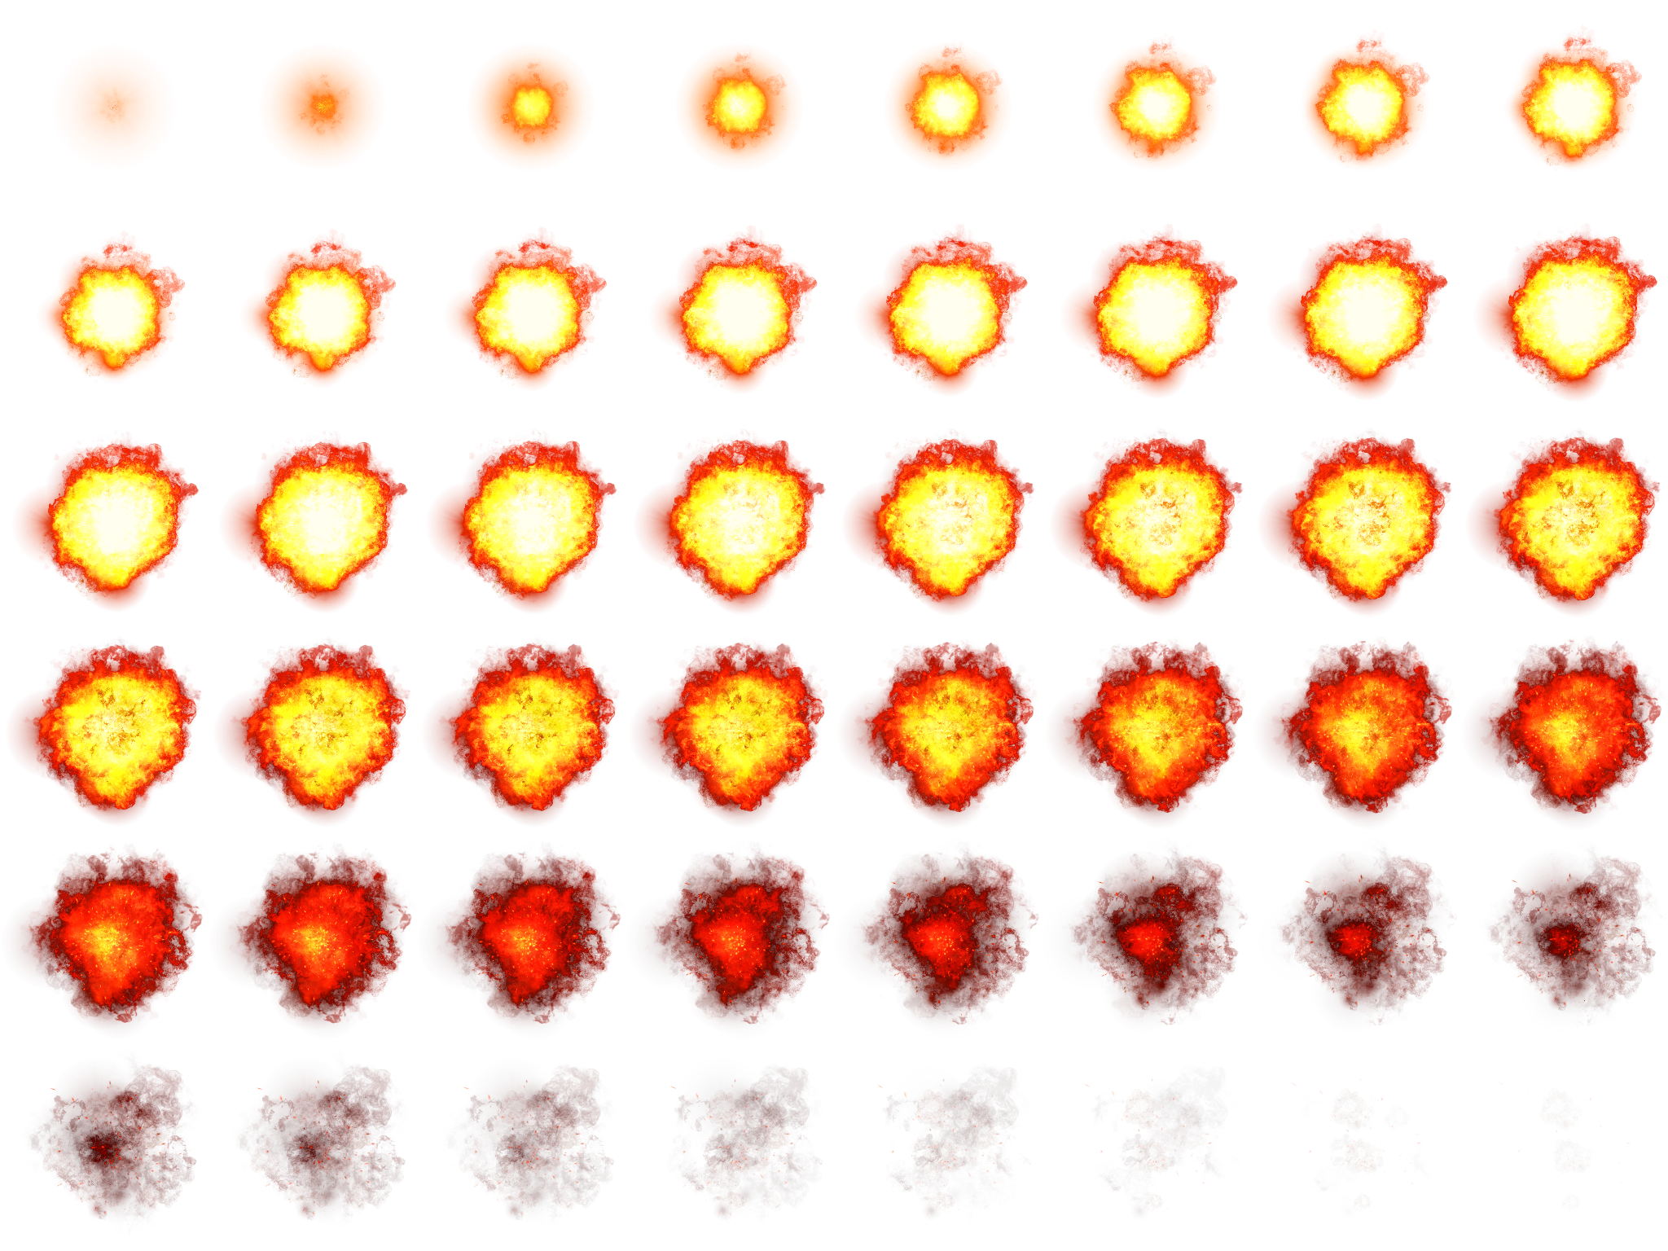

Slide 9





JetB mb

Slide 10


Slide 12



Slide 13





Slide 14


Slide 15











Slide 17

Easy
Normal
Hard

Slide 19





